Slide 1
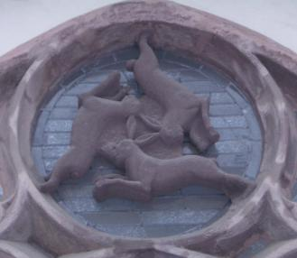
Stereochemistry
Stereochemistry refers to the 3-dimensional properties and reactions of molecules. It has its own language and terms that need to be learned in order to fully communicate and understand the concepts.

Slide 2
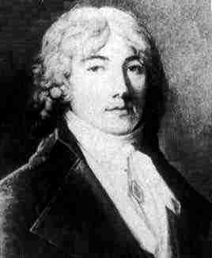
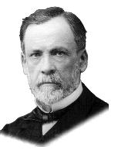
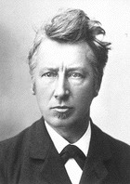
Founding Fathers of Stereochemistry
Biot
Biot: The solutions of many naturally occurring compounds rotate the plane of polarization of polarized light (1815-1817)
Pasteur recognized in 1850 that this optical activity was caused by an asymmetric arrangement of atoms in a molecule
van’t Hoff and Le Bel described in 1874 how the atoms of a molecule are actually arranged in space
Pasteur
Van’t Hoff

Slide 3
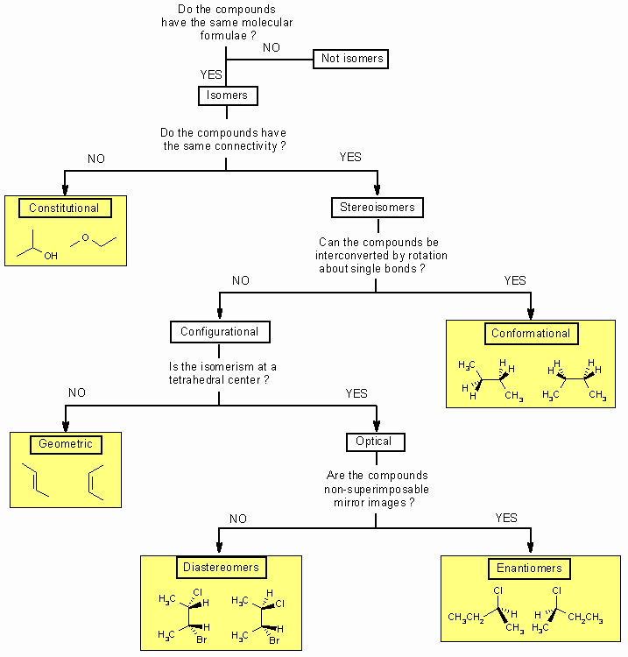

Slide 4
Definitions
Stereoisomers – compounds with the same connectivity, different arrangement in space
Enantiomers – stereoisomers that are non- superimposible mirror images; only properties that differ are direction (+ or -) of optical rotation
Diastereomers – stereoisomers that are not mirror images; different compounds with different physical properties

Slide 5
More Definitions
Asymmetric center – sp³ carbon with 4 different groups attached
Optical activity – the ability to rotate the plane of plane –polarized light
Chiral compound – a compound that is optically active (achiral compound will not rotate light)
Polarimeter – device that measures the optical rotation of the chiral compound

Slide 6
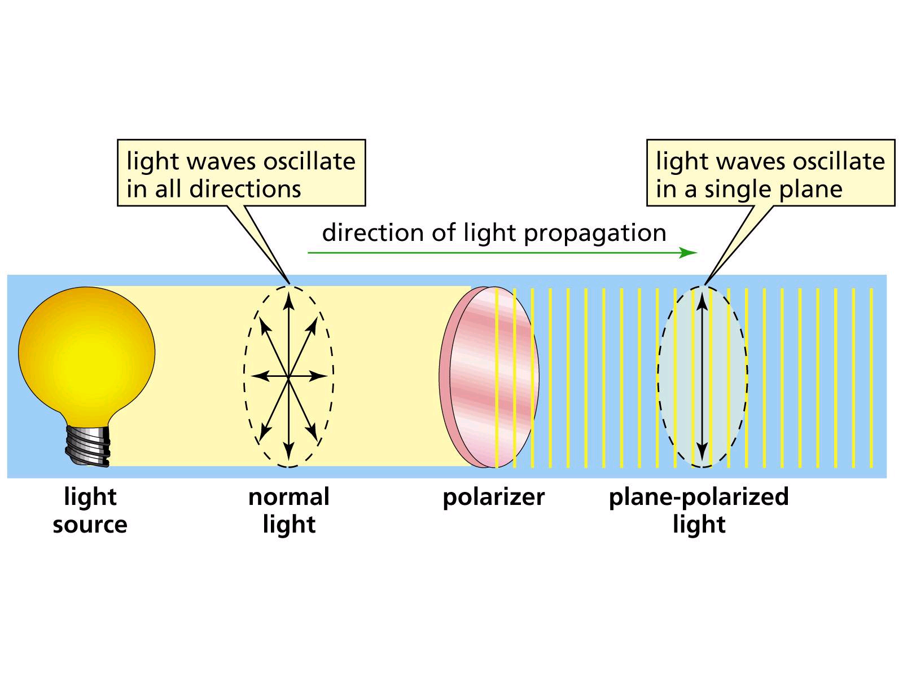
Plane-Polarized Light

Slide 7
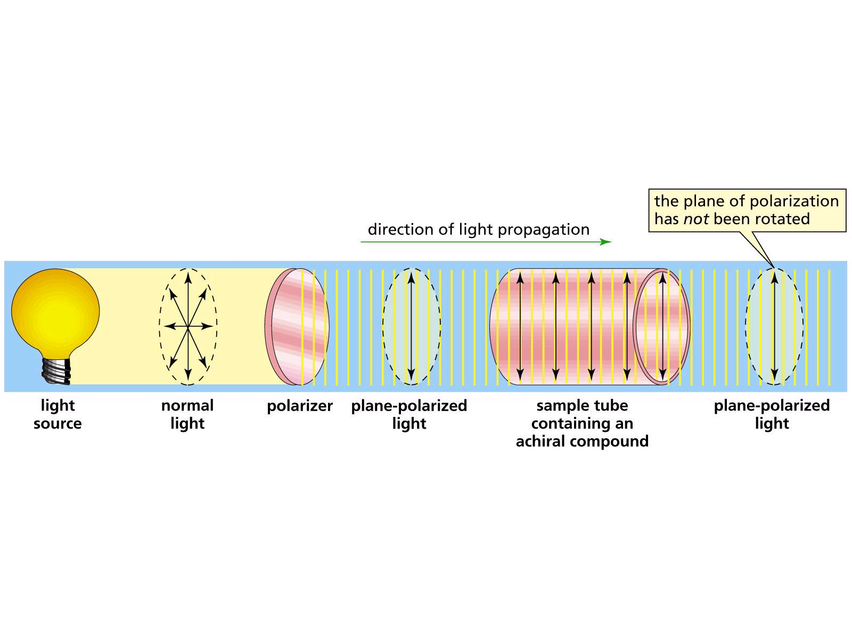
Plane-Polarized Light through an Achiral Compound

Slide 8
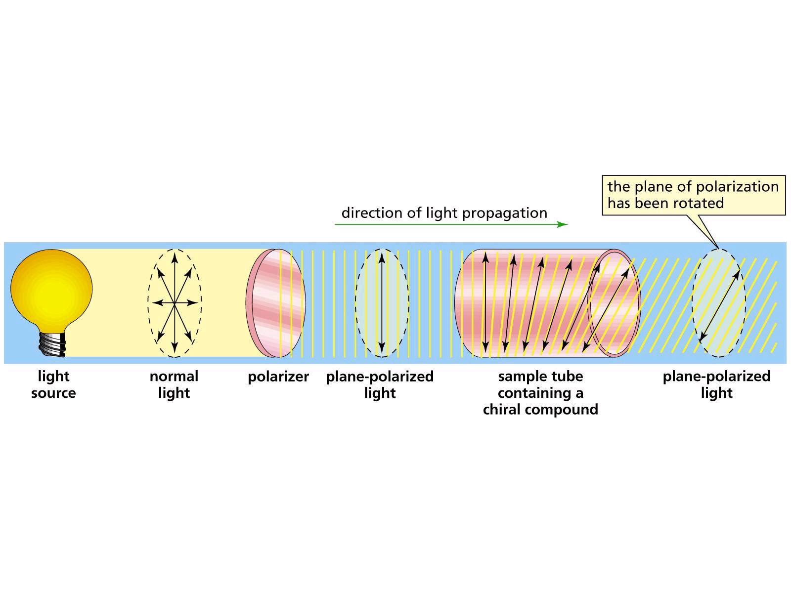
Plane-Polarized Light through a Chiral Compound

Slide 9
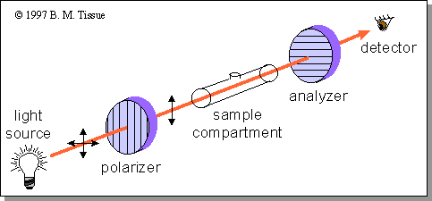
Polarimeter Measures
Optical Rotation

Slide 10
Specific Rotation, [α]
[α] = α / cl
α = observed rotation
c = concentration in g/mL
l = length of tube in dm
Dextrorotary designated as d or (+), clockwise rotation
Levorotary designated as l or (-), counter- clockwise rotation

Slide 11
Specific Rotations of some Common Organic Compounds
Compound [α] # * centers
Penicillin V +233.0 3
Sucrose +66.5 10
Camphor +44.3 2
MSG +25.5 1
Cholesterol -31.3 8
Morphine -132.0 5

Slide 12
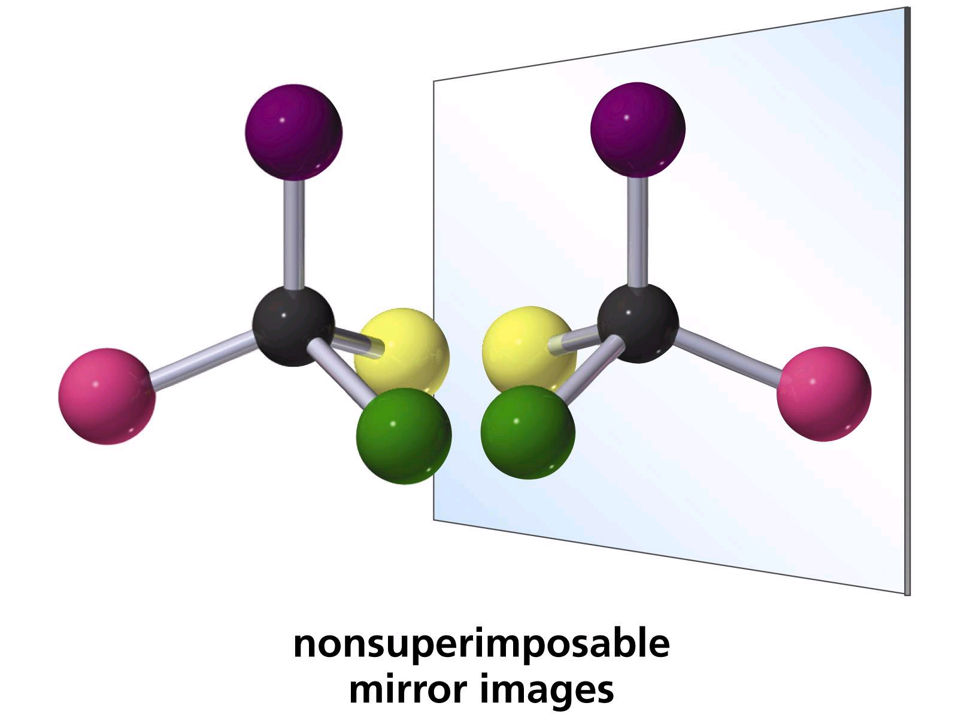
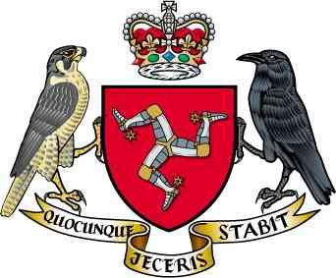
Chirality Center
Carbon has four different groups attached

Slide 13
A molecule with a single stereogenic center must be chiral.
But, a molecule with two or more
stereogenic centers may be chiral
or it may not
Notes:
18

Slide 14
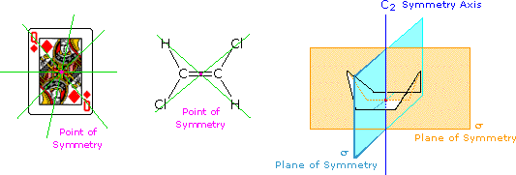
Molecular Asymmetry
Chiral axis
Chiral plane
Chiral centre

Slide 15
Symmetry tests for achiral structures
Any molecule with a plane of symmetry
or a center of symmetry must be achiral.
Notes:
18

Slide 16
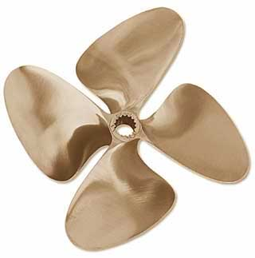
Rotational Axis

Slide 17
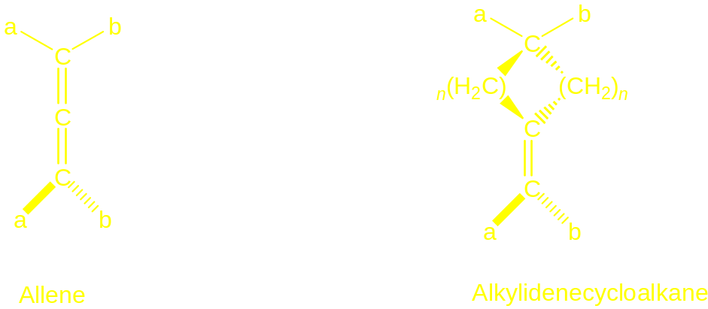
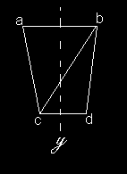
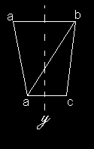
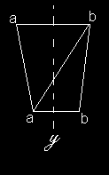
Chiral Axis

Slide 18
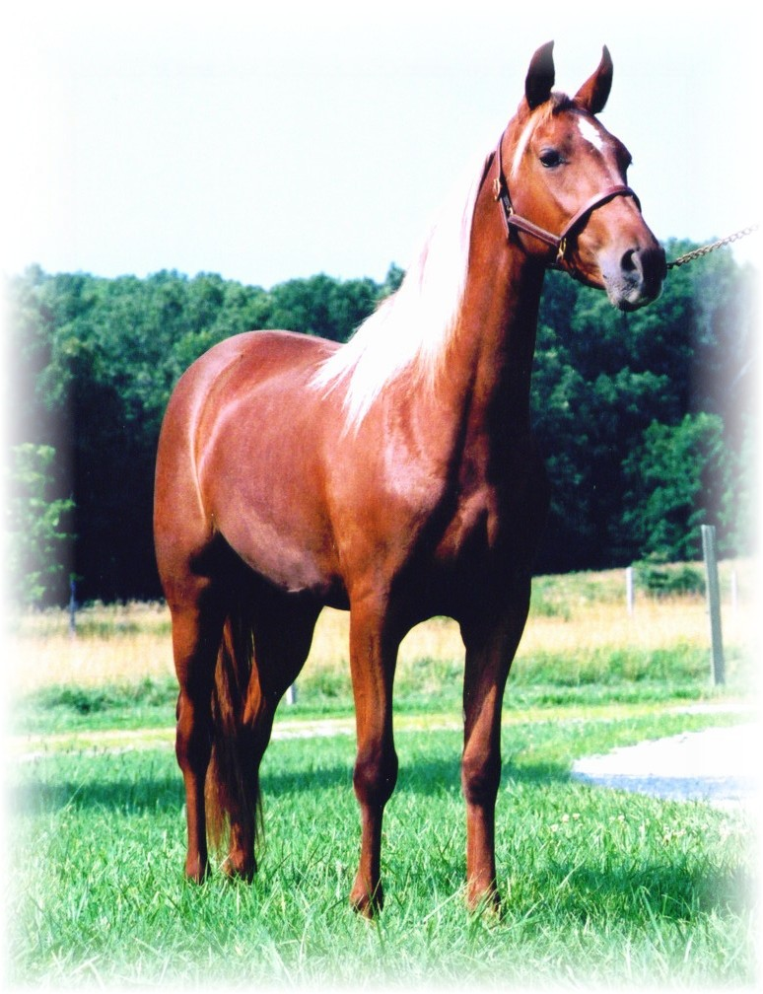
Reflection Plane

Slide 19
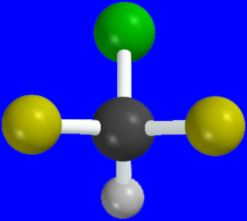
Plane of symmetry
A plane of symmetry bisects a molecule into two
mirror image halves. Chlorodifluoromethane
has a plane of symmetry.
Notes:
21

Slide 20
Plane of symmetry
A plane of symmetry bisects a molecule into two
mirror image halves. Chlorodifluoromethane
has a plane of symmetry.
Notes:
21

Slide 21
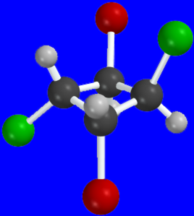
Center of symmetry
A point in the center of the
molecule is a center of
symmetry if a line drawn
from it to some element,
when extended an equal
distance in the opposite
direction, encounters an
identical element.
Notes:
21

Slide 22
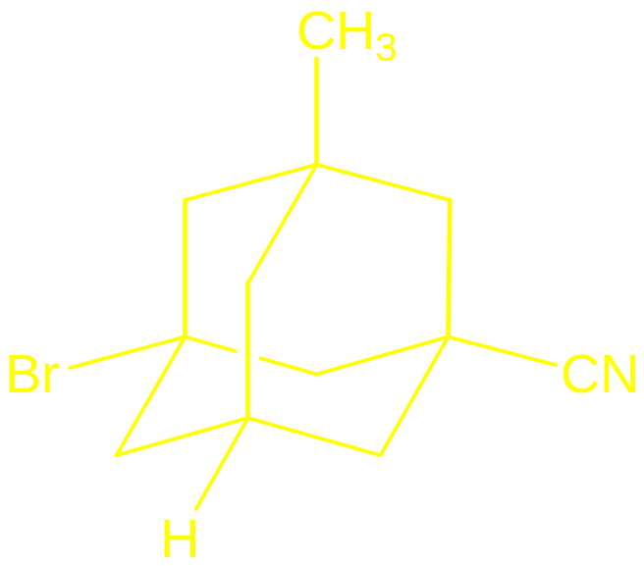
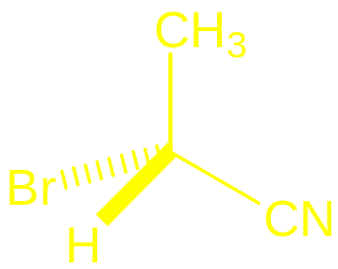
Chiral Centre

Slide 23
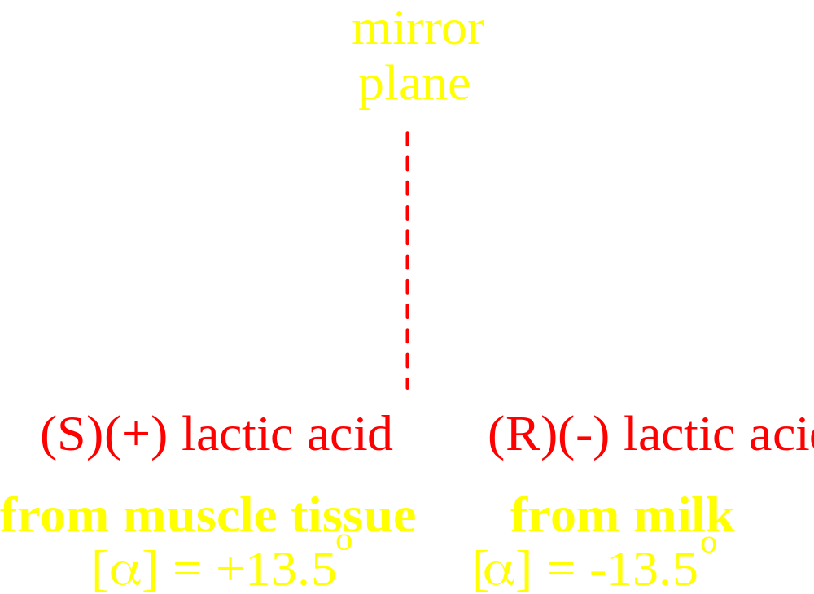
Enantiomers nonsuperimposible mirror images

Slide 24
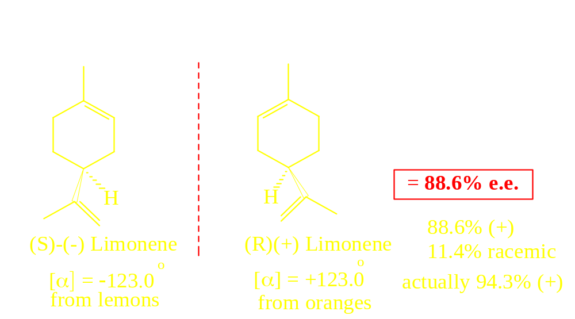
Enantiomeric Excess
(Optical Purity)

Slide 25
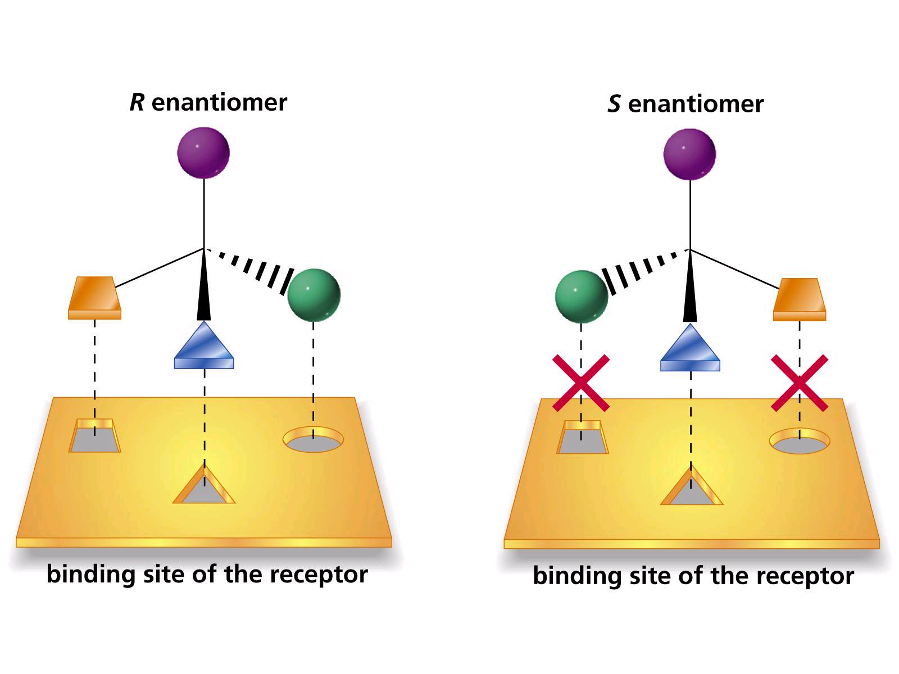

Slide 26
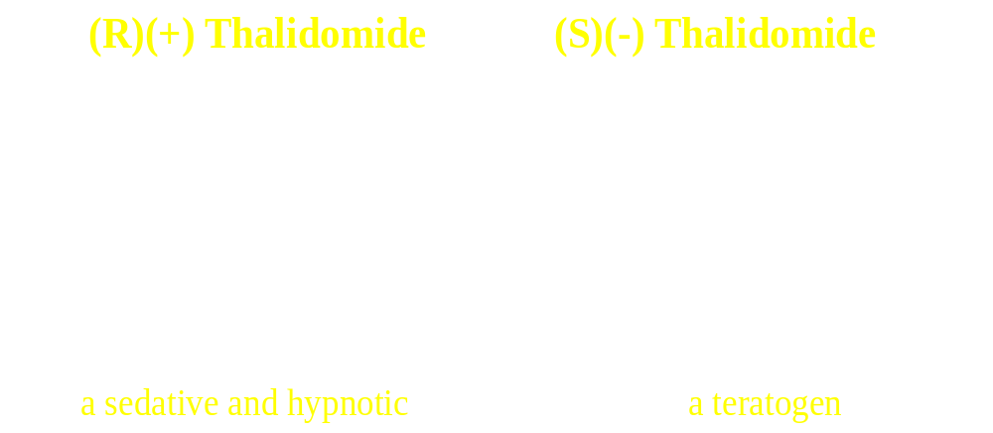
Biological Activity

Slide 27
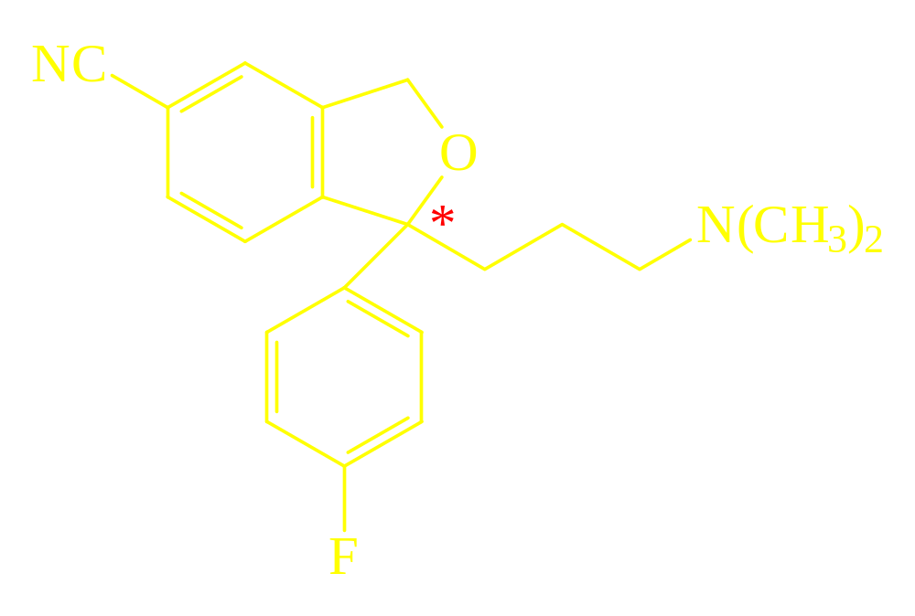
SSRI Efficacy depends on Stereochemistry

Slide 28
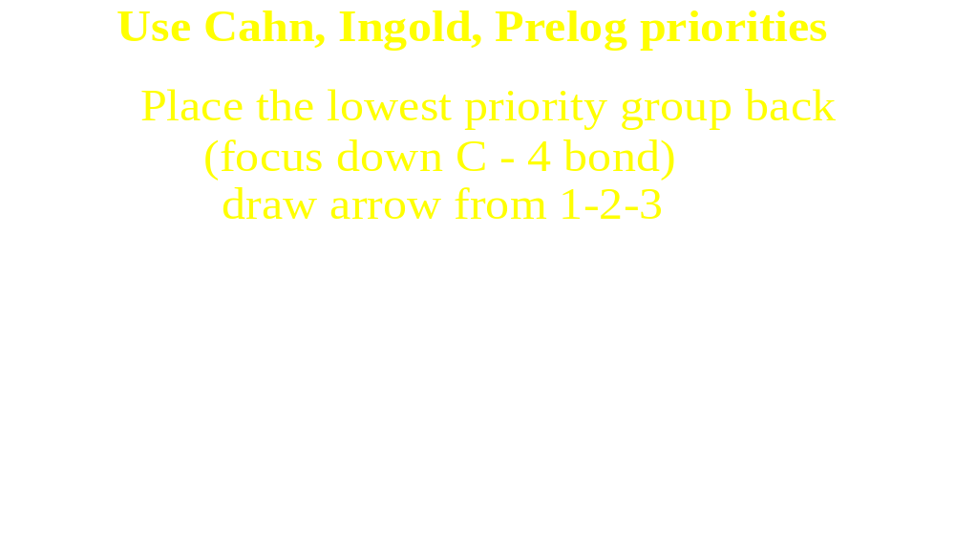
Absolute Configuration

Slide 29
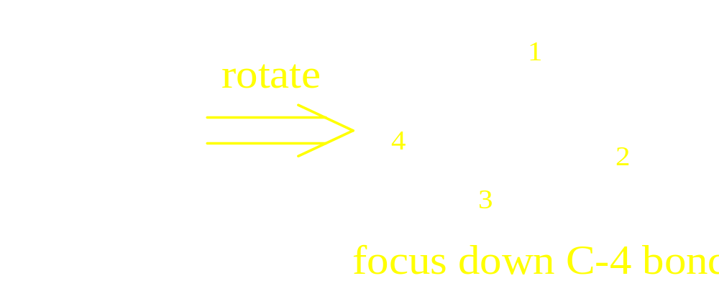
Assign Priority to each Group on Asymmetric Center

Slide 30
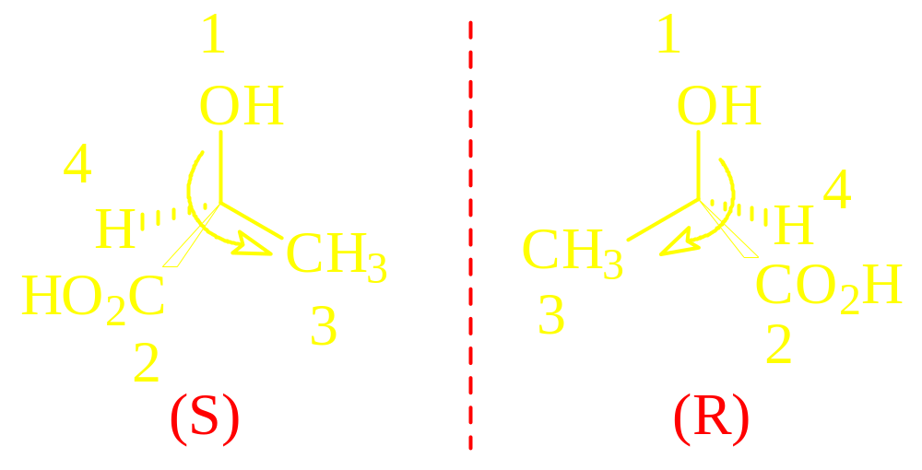
Lactic Acid

Slide 31
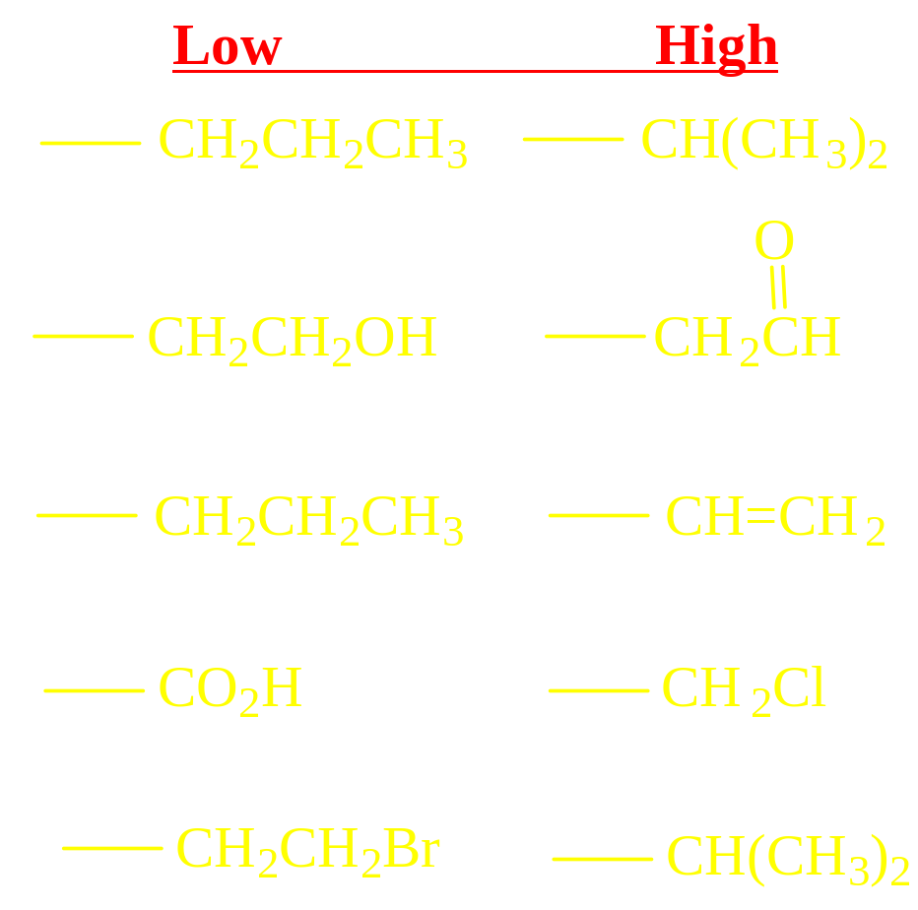
C.I.P. Priorities

Slide 32
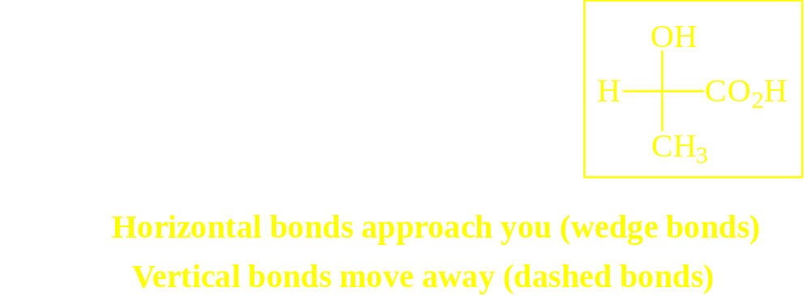
Fischer Projections

Slide 33
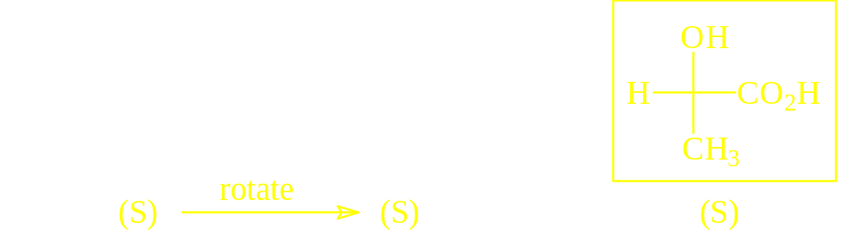
Assigning Absolute Configuration to Fischer Projections

Slide 34
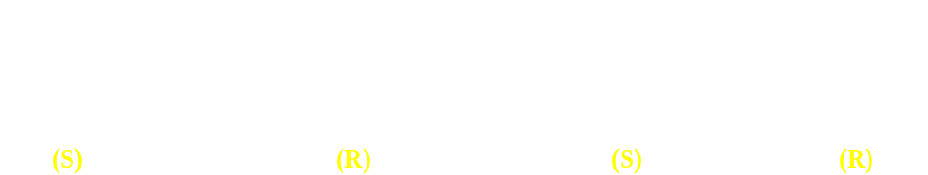
Rotation of the Projection 90º
Reverses Absolute Configuration

Slide 35
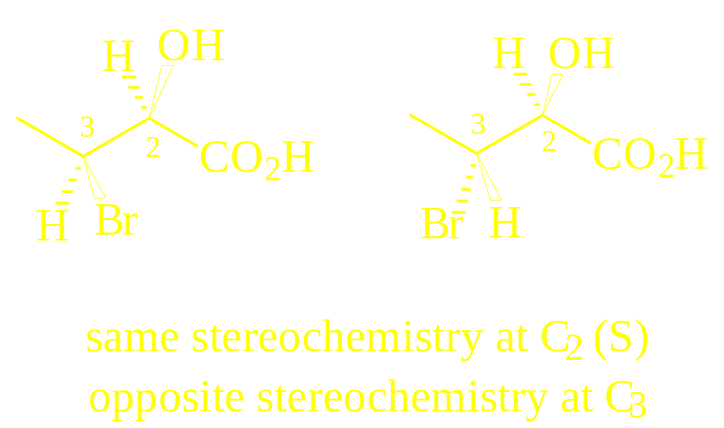
Diastereomers
Stereoisomers That Are Not Mirror Images

Slide 36
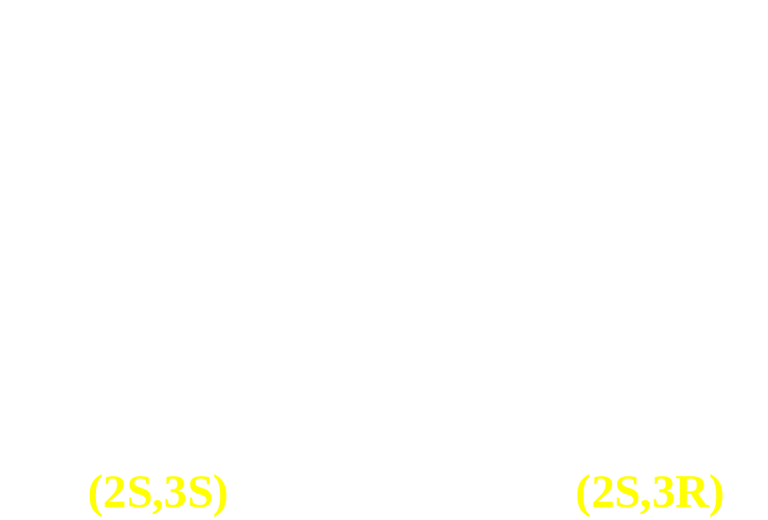
Fischer Projections with 2 Chiral Centers

Slide 37
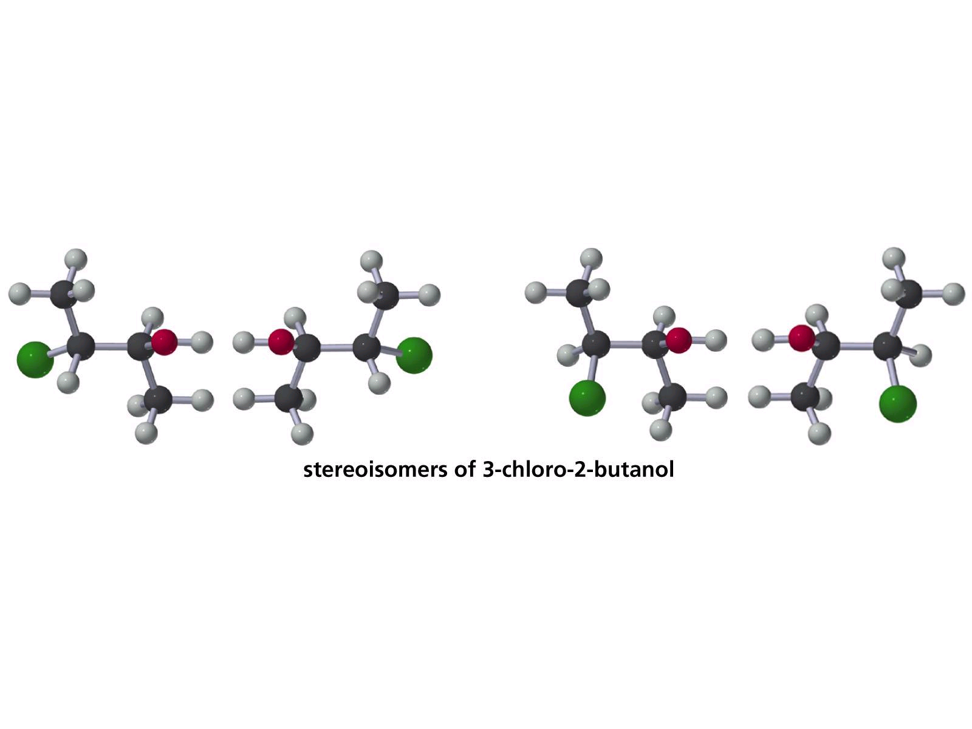
2 Chiral Centers
4 Stereoisomers

Slide 38
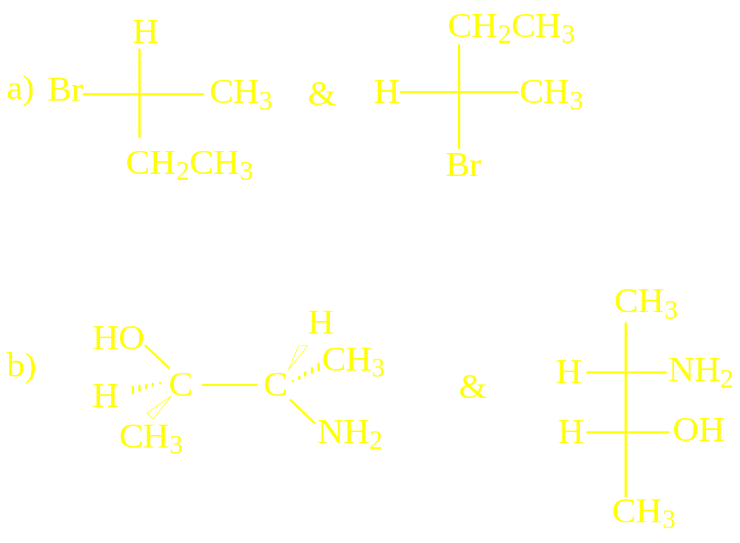
Identical, Enantiomers or Diastereomers?

Slide 39
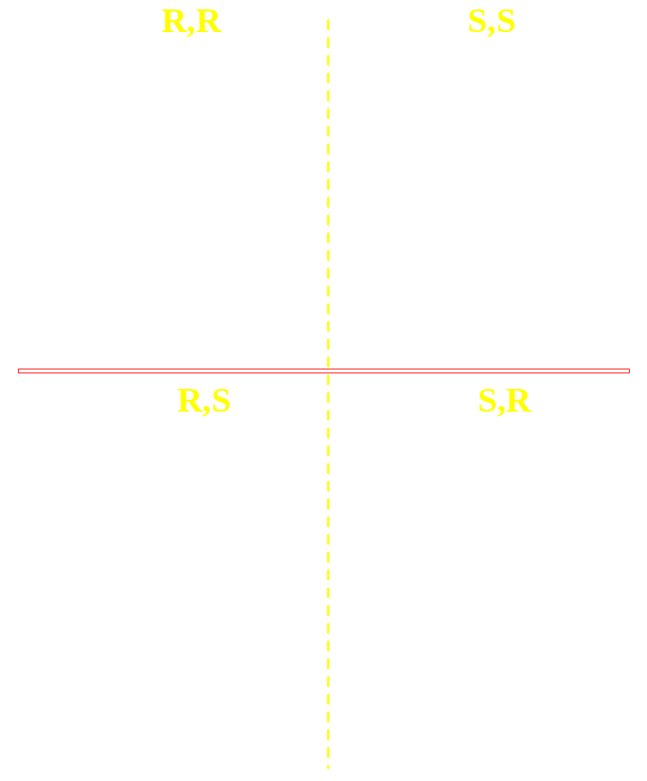
Tartaric Acids

Slide 40
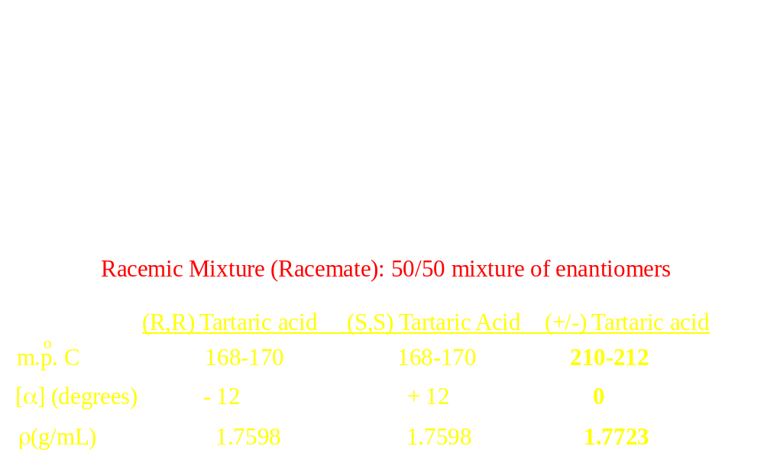
Racemic Mixture

Slide 41
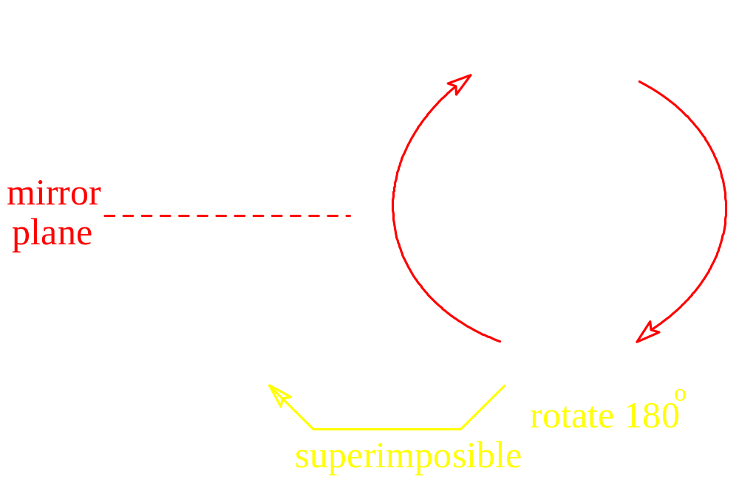
Meso Compound
Internal Plane of Symmetry
Optically Inactive

Slide 42
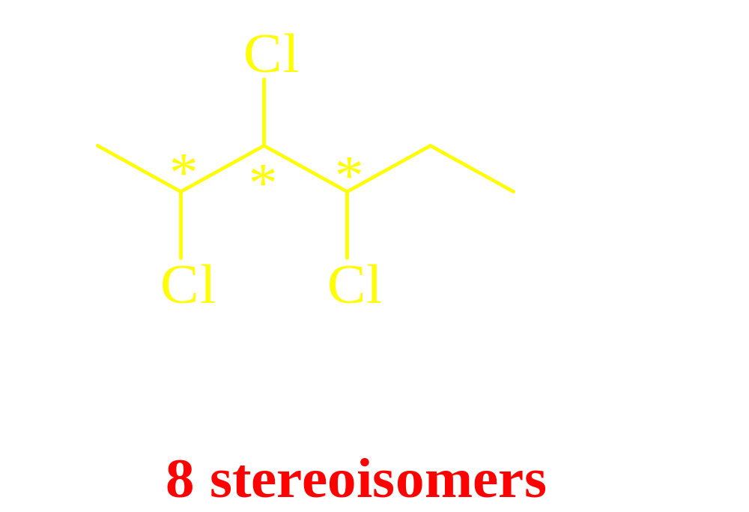
2,3,4-trichlorohexane
How many stereoisomers?

Slide 43
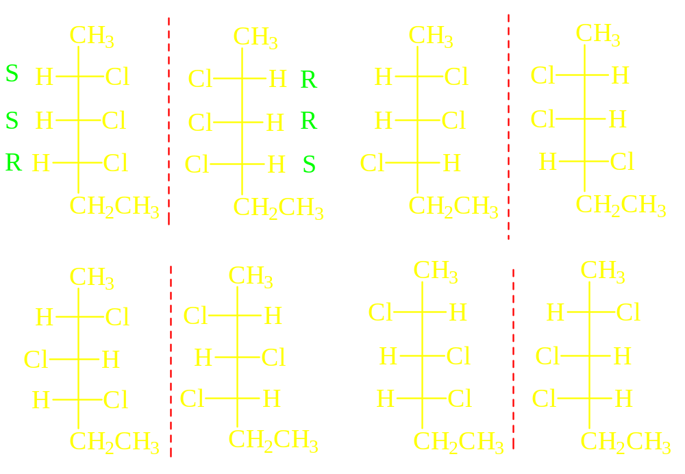
n = 3; 2^{n} = 8

Slide 44
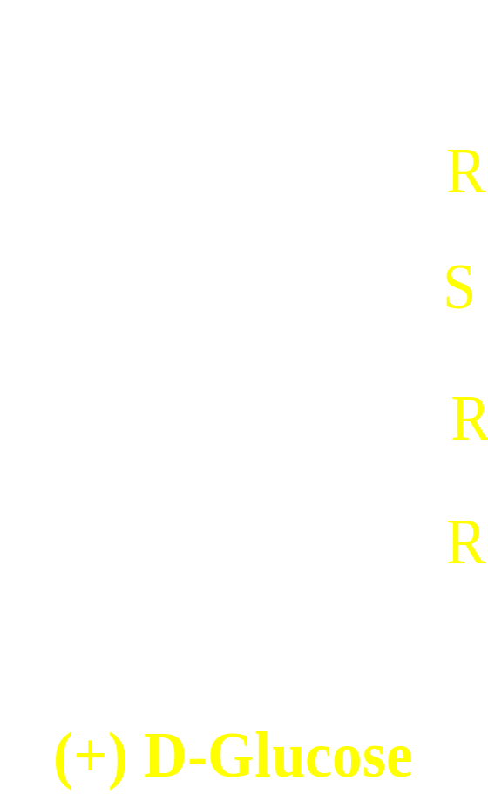
A Carbohydrate

Slide 45
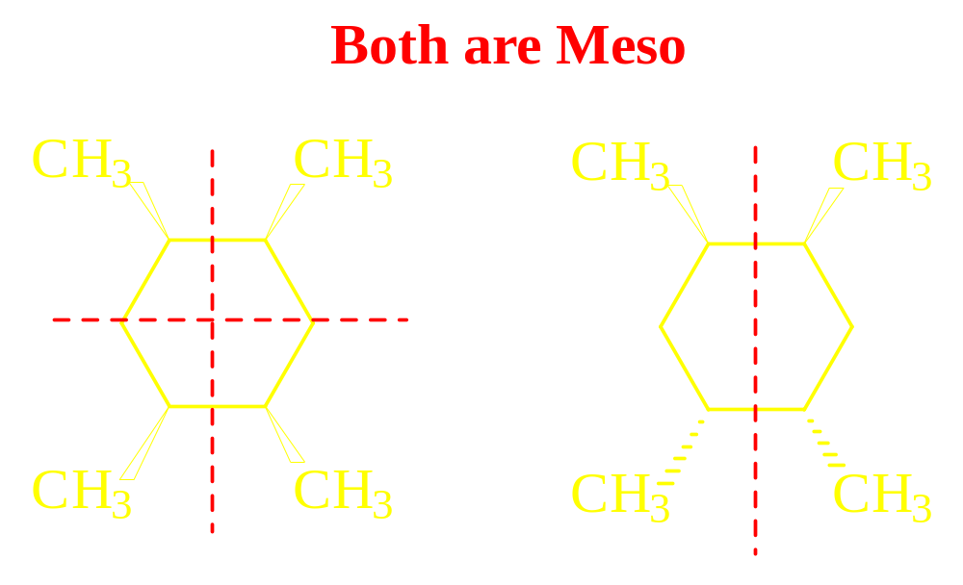
Internal Planes of Symmetry

Slide 46
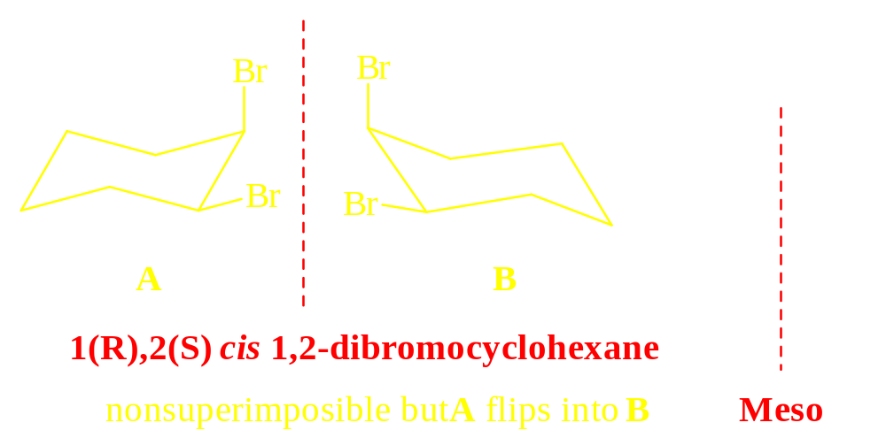
Asymmetric Centers on Rings

Slide 47
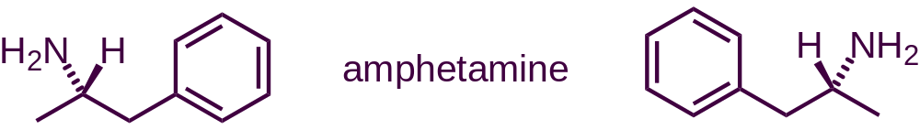
Different enantiomers of a drug can have different effects.
stimulant
adverse cardiovascular effects

Slide 48
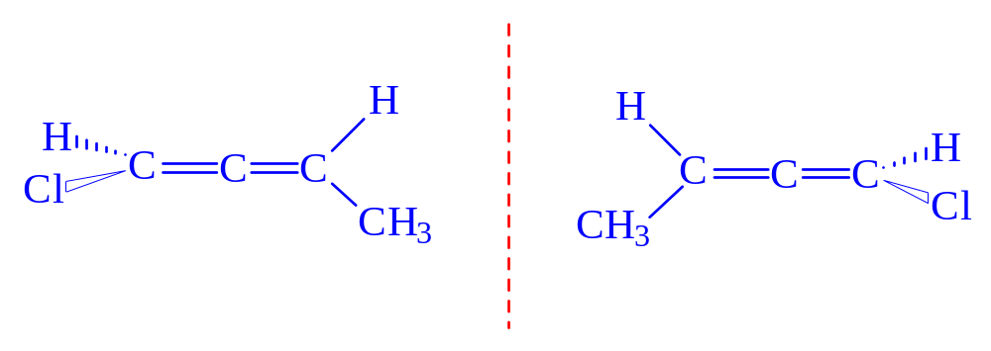
Allenes can be Chiral

Slide 49
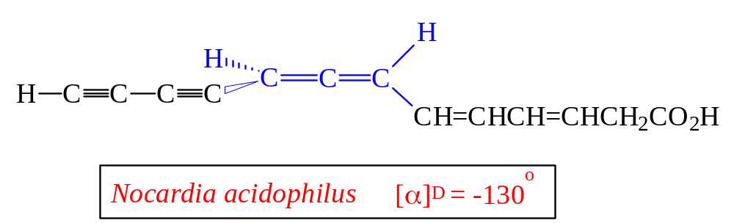
Mycomycin, an antibiotic

Slide 50
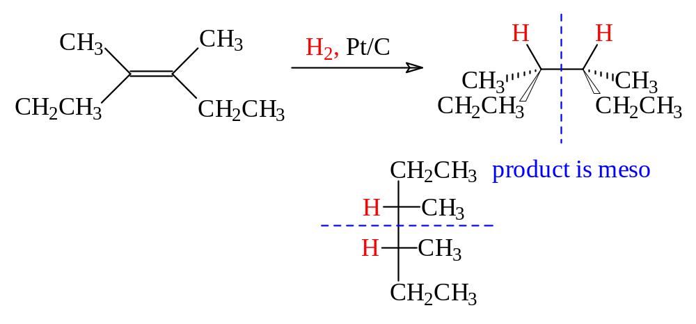
Reactions that Generate Chirality Centers
Hydrogenation, syn

Slide 51

Bromination
Trans is formed exclusively
No Meso is formed (cis)

Slide 52

Bromonium Ion is Opened Equally from Both Sides

Slide 53

trans alkene + anti addition = MESO

Slide 54

cis Alkene + anti addition = racemic mixture

Slide 55

Brominations Often Generate Asymmetric Centers

Slide 56

Asymmetric Center is Generated
Racemic Mixture Formed

Slide 57

Asymmetric Induction

Slide 58

Preparation of (L)-Dopa for Treatment of Parkinson’s

Slide 59

Relevance of Stereochemistry

Slide 60

One-step synthesis

Slide 61

α-(p-isobutylphenyl)propionic acid

Slide 62

Model of Thalidomide

Slide 63

How Sweet it is!
Sucralose is 600 times sweeter and does not get metabolized.

Slide 64

Sildenafil (Viagra) and Caffeine

Slide 65

Radiosensitizer of Choice Until 2004

Slide 66

Questions/Remarks ?

